Slide 1
Object Oriented Programming
(type parameter, generics, ArrayList)

Slide 2
Type safe method call
Method parameters – type safe, checks made by compiler and JVM
Return type specifies type of return value
Type check of return value is made in compile time
Type of formal parameters specify actual parameter types
Matching formal and actual parameters are made in compile and run-time
Number
Type

Slide 3
Method for generic purpose
What to do when same operation has to be executed on different types?
Generalization
Same behavior with type dependent operation → overload
Behavior with type independent operation
Independent on a given abstraction level: usage of base class – Object
Generic programming – usage of type parameter

Slide 4
Type dependent operations
Handler method does access components of subject class
Type safe parameter is required to provide interface specification
Parameter type specified at compile time
Functionality:
Parameters of different types are used for the same logical operation – behavior
Parameter object participates in realization of behavior
Method: Method overload

Slide 5
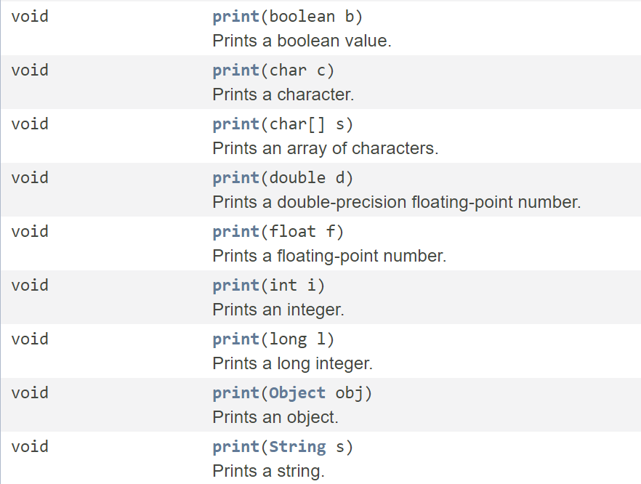
Type dependent implementations of a behavior
print method
implementations of
PrintStream class

Slide 6
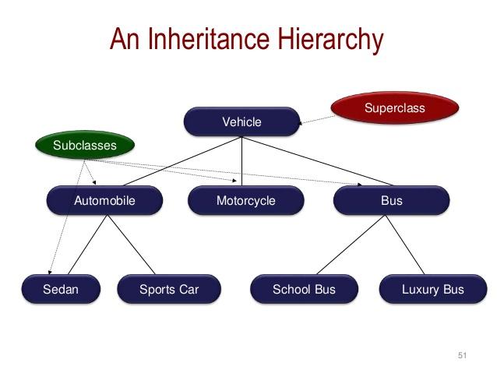
Class hierarchy – ancestor class
Application of the base class
All subclasses can be casted to this
Interface of common type is accessible
Root of class hierarchy is Object

Slide 7
Casting Up
Casting up on class hierarchy tree until the root – valid
Any object can be casted to Object implicitly and explicitly
This cast does not change type of referenced object
This cast creates a new reference with new type – base class Specifies the interface of communication

Slide 8
Casting Up – example
Car car = new Car();
Vehicle vehicle = car; // Valid
Object vehicleObject = car; // Valid
// Reserved object is still a Car,
// but can be accessed via Car, Vehicle and Object interfaces,
// specified by references above

Slide 9
Type independent operations
Basically, handler class does not access components of subject class
For example: array based general storage
Functionality:
Reusable for more classes
Parameter object does not participate in realization of behavior
Method: base class

Slide 10
Base class storage
Vehicle[] cars = new Vehicle[10];
cars[0] = new Car();
cars[2] = new Car();
Object[] trucks = new Object[10]; // Could also be Vehicle
trucks[0] = new Truck();
trucks[1] = new Truck();
Vehicle[] buses = new Vehicle[10];
buses[0] = new Bus();
buses[2] = new Bus();

Slide 11
Base class storage – combined
Vehicle[] vehicles = new Vehicle[10];
vehicles[0] = new Car();
vehicles[1] = new Bus();
vehicles[2] = new Truck();
Object[] objects = new Object[10];
objects[0] = vehicles[0];
objects[1] = vehicles[1];
objects[2] = vehicles[2];

Slide 12
Downcast
Implicit cast down or side from reference in class hierarchy tree is NOT valid
Object reference can be casted explicitly to any class – compile time
Explicit cast is type checked at run time → ClassCastException
Cast is valid, when interface of object contains required interface:
Downcast on the same branch
Downcast until the type of the allocated object type

Slide 13
Downcast example
Vehicle[] vehicles = new Vehicle[10];
vehicles[0] = new Car();
Object[] objects = new Object[10];
objects[0] = vehicles[0];
Car car = (Car)vehicles[0];
Car car = (Car)objects[0];
SportCar car = (SportCar)vehicles[0]; //Invalid
SportCar car = (SportCar)objects[0]; //Invalid

Slide 14
Use of objects
if(objects[0] instanceof Car) {
Car car = (Car)objects[0];
}
if(objects[0] instanceof Bus) {
Bus bus = (Bus)objects[0];
}
…
Check instantiated classes!
<type>.class.isAssignableFrom(<object>)

Slide 15
Really generic implementation
To create a really generic implementation programmer has to
Create many implementations for different base classes
Or
Use the root class (Object) as storage type

Slide 16
Generic implementations
Implementations by type
Base subject class
Type safe in compile time, parameter types can be checked
Interface of stored objects is specified
Multiple implementations
Compile time type safety is lost, everything is an Object
Interface of stored objects is not specified
Single implementation

Slide 17
Type safety with single implementation
Combine benefits of pervious appearances
Type safe at compile time
Specification of subject interface at compile time
Single implementation to handle many types
Stored objects can participate in behavior
Type parameter is introduced
Declared and checked in compile time

Slide 18
Type parameter
A placeholder in declaration
Can be used in method declaration and body
Set at the call of a generic method but in compile time
Evaluated/checked at compile time
Type safety is guaranteed at run time (by compile time check)
Can not be primitive type
Setting can be inferenced from method call
The source code (implementation) of a method is generic for all types, but the instance does not work with any types.
The subject type has to specified at compile time.

Slide 19
Type parameter
Methods can have type parameters to make them generic
Type parameter section
Precedes the return type
Delimited by angle brackets ”<” and ”>”
Contain one or more type parameter, separated by comas ”,”
Type parameters can be used anywhere in method declaration

Slide 20
Generic method declaration
<visiblity> [type parameters] <return type> <method name>([formal parameters])
{
<method body>
}
public <T> void print(T item) {
System.out.println(item);
}

Slide 21
Generic method – example
public <T> T getItem(T item) {
return item;
}
Car car = getItem(new Car()); //No effect, returns the object
// Type parameter is inferred from method argument
// Type of variable and return type is checked at compile time

Slide 22
Type parameter constraints
When handler class wants to use services/components of instance of subject class, accessing interface has to be known
Restrictions have to be defined about subject class
Specification of interface (class) to use in class hierarchy
Type parameter can not be instantiated directly!

Slide 23
Restricted Generic method declaration
<visiblity>
[<type parameter> extends <superclass>]
<return type> <method name>([formal parameters])
{
<method body>
}

Slide 24
Generic method – bounded type
public <T extends ClassWithValue> T incrementValue(T item) {
item.setValue(item.getValue() + 1);
return item;
}
// ClassWithValue methods: getValue, setValue
Product product = incrementValue(new Product());
//Product is a subclass of ClassWithValue

Slide 25
Generic class
Collection of generic methods can be encapsulated in a generic class
Generic class
All methods work with same type(s) given as parameter(s)
Type parameters set for the whole class at compile time

Slide 26
Generic class example
class Storage<T> {
private T[] items; // Can not be instantiated
private int lastIndex = 0;
public Storage(T[] emptyArray) { items = emptyArray; }
public void addItem(T newItem) { items[lastIndex++] = newItem; }
public T getItem(int index) { return items [index]; }
}

Slide 27
Generic class usage – example
Storage<Car> carStorage = new Storage<Car>(new Car[5]);
carStorage.addItem(new Car());
carStorage.addItem(new Car());
Storage<Bus> busStorage = new Storage<Bus>(new Bus[5]);
busStorage.addItem(new Bus());
busStorage.addItem(new Bus());

Slide 28
Generic class usage example – up-/downcast
Storage<Vehicle> vehicleStorage =
new Storage<Vehicle>(new Vehicle[5]);
vehicleStorage.addItem(new Car()); // index: 0
vehicleStorage.addItem(new Bus()); // index: 1
Bus bus = (Bus)vehicleStorage.getItem(1);
Bus otherBus = (Bus)vehicleStorage.getItem(0); //Invalid!!!

Slide 29
Generic List class
public class ArrayList<T> { … }
Generic storage class:
Variable storage space (increase, decrease)
Array like indexing
Built-in sort
Developer documentations
(https://docs.oracle.com/javase/8/docs/api/java/util/ArrayList.html)

Slide 30
ArrayList methods
clear – clear the list
add – add new item
contains – check if list contains item (by reference, not by value)
get – get item
isEmpty – check if list is empty
remove – remove item
set – set item at a specified index
size – get list size

Slide 31
Usage of ArrayList
ArrayList<Vehicle> vehicles = new ArrayList<Vehicle>();
// Upcasts done implicitly
vehicles.add(new Car());
vehicles.add(new Bus());
vehicles.add(new Truck());
// Downcasts have to be checked by programmer

Slide 32
Built-in sort
ArrayList<Integer> ints = new ArrayList<>();
for(int i=0;i<100;i++) { ints.add(getRandomInt()); }
Collections.sort(ints);
ArrayList<String> strings = new ArrayList<>();
for(int i=0;i<100;i++) { strings.add(getRandomString()); }
Collections.sort(strings, Collections.reverseOrder());

Slide 33
Comparator
Comparison of items is required for appropriate operation of sorting algorithms
Done by comparator method
Declaration:
int <method name>(<type> o1, <type> o2)
Where return value <0 if o1<o2, =0 if o1=o2 and >0 if o1>o2,

Slide 34
Built-in sort with comparator
Collections.sort(<collection>)
Sort items into ascending order
Collections.sort(<collection>, <comparator>)
Instead of default comparer other also can be used Collections.reverseOrder() – reversed direction comparer

Slide 35
ArrayList.sort()
ArrayList.sort(<comparator>)
Sort elements with a given comparator
Always have to specify a comparator – no default
Default reversed comparer can be applied (or its inverse)
ArrayList<String> strings = new ArrayList<>();
for(int i=0;i<100;i++) { strings.add(getRandomString()); }
Collections.sort(strings, Collections.reverseOrder());
strings.sort(Collections.reverseOrder());

Slide 36
Custom comparator
The default comparators are not usable for custom classes, because exact specification of properties participating and the exact comparison method have to be specified.
Comparison of hidden state descriptors will be shown later (when explaining interfaces)
For comparison of public state descriptors, custom comparators can be written

Slide 37
Custom comparator
The comparator method
declaration as shown before
int <method name>(<type> o1, <type> o2)
Name can be anything
Type is the type to compare
Stateless method → class method, static method

Slide 38
Custom comparator
class Car {
public static int carComparer(Car c1, Car c2) {
return c1.getLicense().compareToIgnoreCase(c2.getLicense());
}
…
}
ArrayList<Car> cars = new ArrayList<>();
…
cars.sort(Car::carComparer);

Slide 39
Anonymous function
The anonymous function is
a function, which is not bound to any variable (no name or reference is given at declaration)
created in a code block, therefore it is an embedded function
has access to variables of containing code block
alternative name: lambda function

Slide 40
Lambda function
Syntax:
<parameters> <lambda operator ”->”> <function body>
Return type, when method body:
an expression, the return value is that
a code block, then return value of the code block
if code block has no return value, returning void

Slide 41
Lambda function
No parameters () -> System.out.println("No Params");
Multiple parameters (param1, param2) -> param1 + param2;
Multiple typed parameters (int i, String name) -> System.out.println("id:" + i + " name:" + name);
Code block with multiple parameters (int param1, int param2) -> { return param1 + param2; }

Slide 42
Application of Lambda function
Application of lambda function with two parameters:
Lambda function makes custom comparison
ArrayList<Car> cars = new ArrayList<>();
cars.sort(
(c1, c2) -> c1.getLicense().compareToIgnoreCase(c2.getLicense())
);

Slide 43
Application of Lambda function
Application of lambda function with one parameter:
The lambda function only returns the value to compare
ArrayList<Car> cars = new ArrayList<>();
cars.sort(
Comparator.comparing( c -> c1.getComfortLevel() )
);

Slide 44
Application of Lambda function
Custom comparator with lambda having two parameters
Free to declare the comparison method, even complex conditions could be applied
Built-in (generic) comparator with lambda getter, having one parameter
With simple, generic comparison conditions, more simple to specify only the value to compare

